Slide 1







Brain Tumour
Detection
PRASHANT BHATTARAI
SYED ROMAN
UJJWAL KHATRI
ANISH KHANAL

Slide 2




Agenda
Introduction
Data Analysis
DataModeling
Conclusion

Slide 3




Introduction
A brain tumor is a collection, or mass, of abnormal cells in your brain.
It is caused by a group of tissues that grows irregularly in the brain. Recently it has become a major cause of death.
It is one of the most dangerous diseases which requires early and accurate detection methods.
Brain tumors can be cancerous (malignant) or noncancerous (benign).

Slide 4




Data Analysis

Slide 5
Data Source
We have taken through Kaggle
https://www.kaggle.com/code/arkalodh/brain-tumor-detection-classification

Slide 6
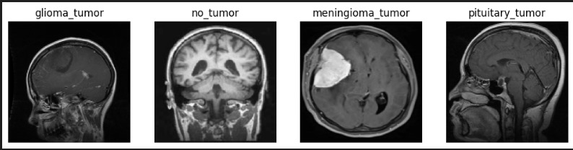
This dataset contains 7023 images of human brain MRI images which are classified into 4 classes: glioma - meningioma - no tumor and pituitary.

Slide 7
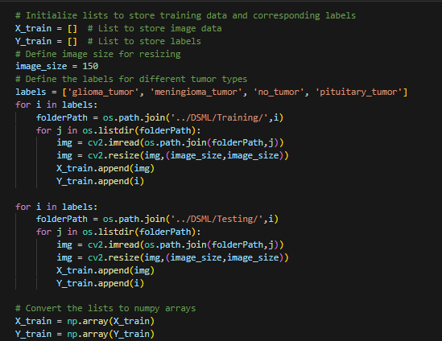
Data Preprocesing

Slide 8
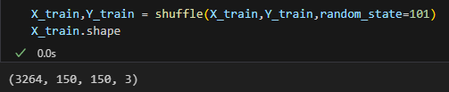
Data Shuffling

Slide 9
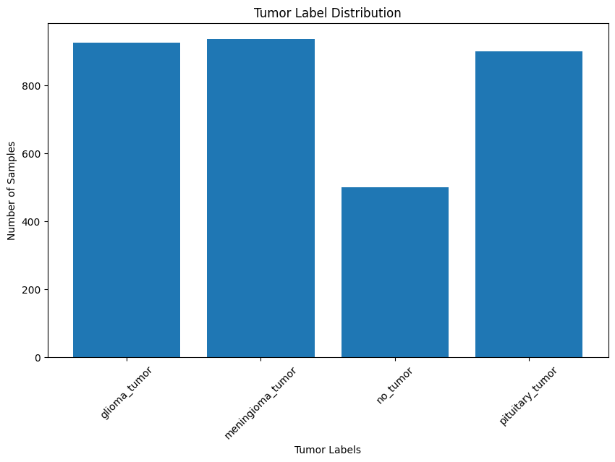
Tumor Types Distribution

Slide 10


DataModelling
Convolutional Neural Network
A Convolutional Neural Network (CNN) is a specialized artificial neural network designed to process visual data like images and videos.

Slide 11

CNN
A Convolutional Neural Network (CNN) is a type of artificial neural network that's particularly good at analyzing visual data, like images and videos. It's inspired by the way our brains process visual information.
they can learn to identify important patterns in images without needing explicit programming. This has made them incredibly useful in tasks like image recognition, object detection, facial recognition, and more.

Slide 12
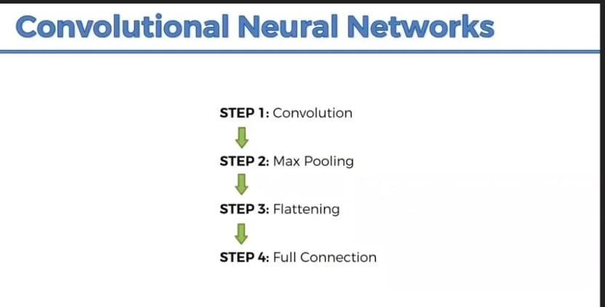
How CNN works?

Slide 13
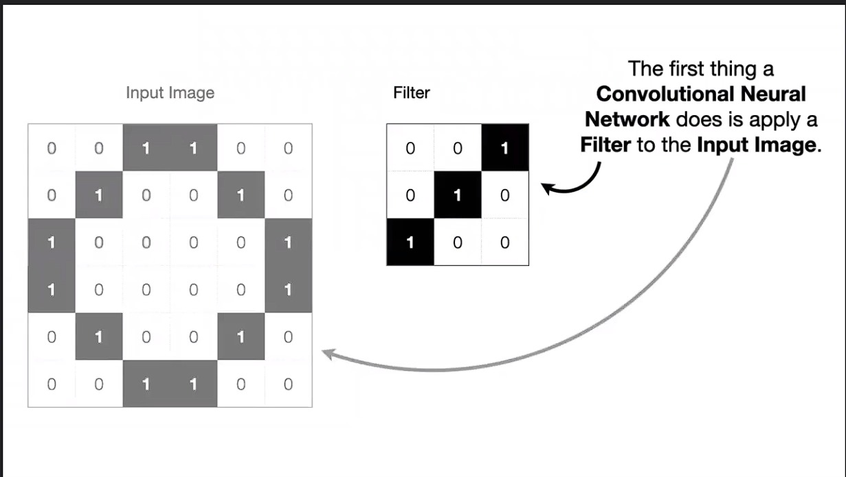
Step-1a:
Convolution layer

Slide 14
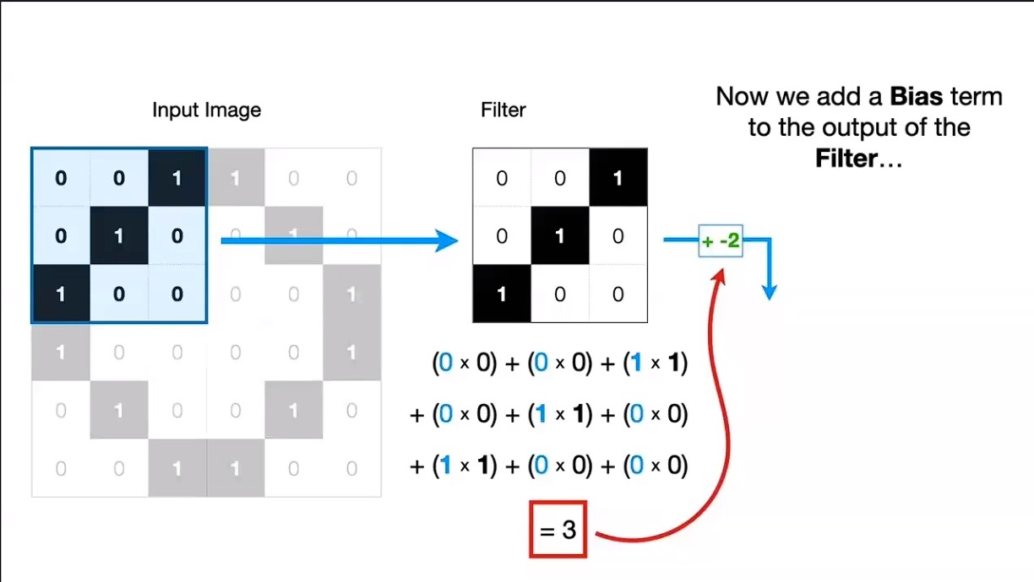
Step-1a:

Slide 15
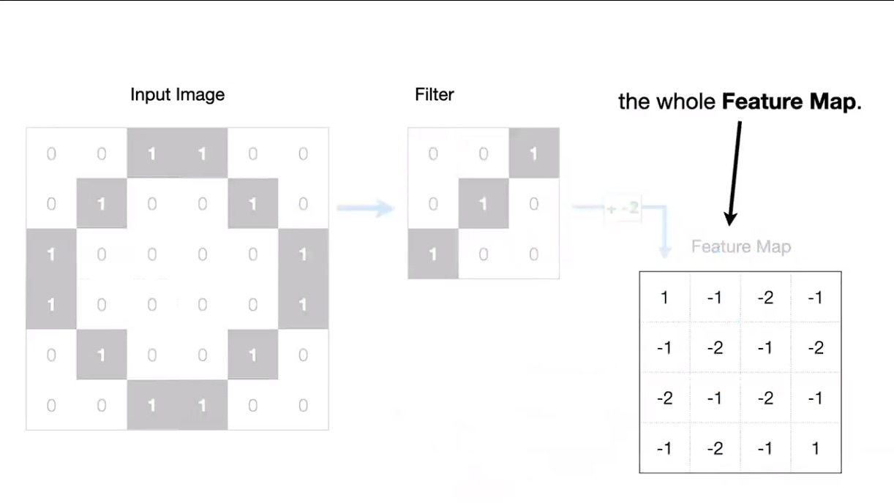
Step-1a:

Slide 16
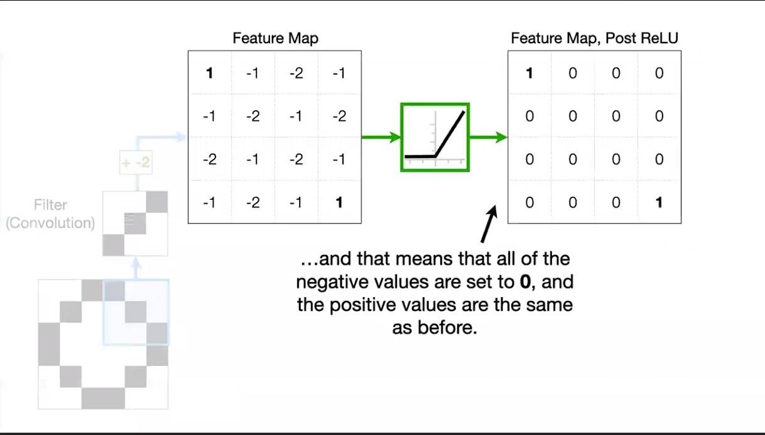
Step-1b:
Relu layer

Slide 17

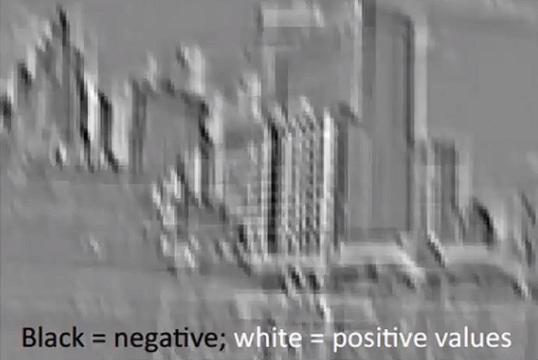
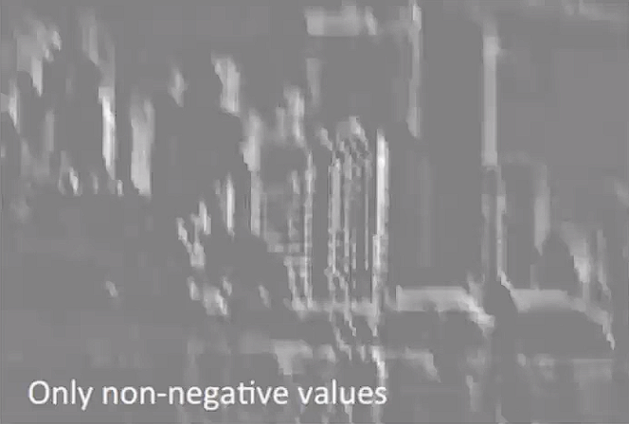

Slide 18
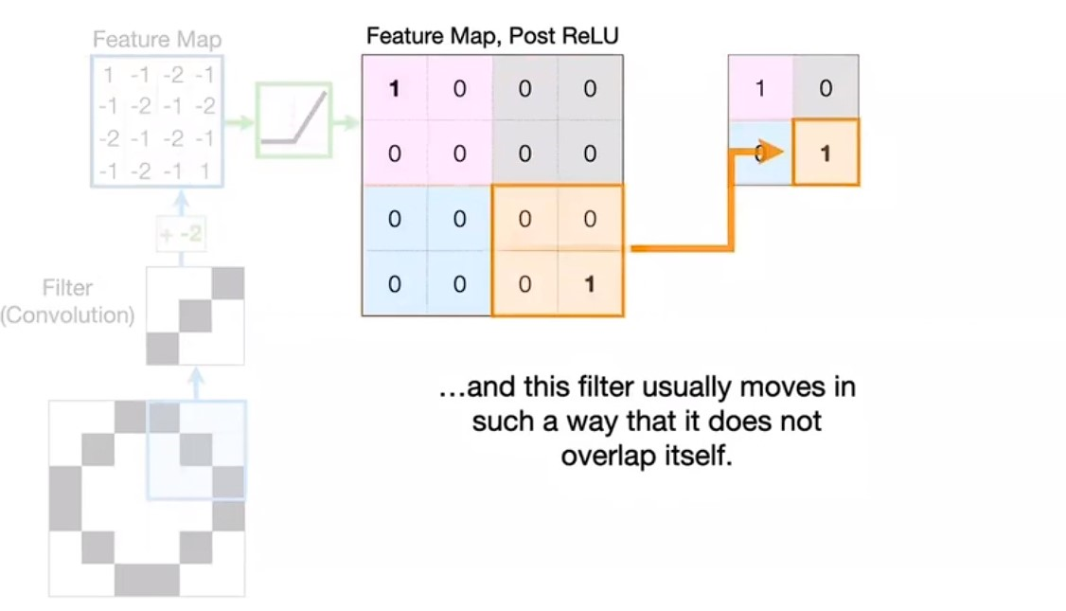
Step-2:
max pooling

Slide 19
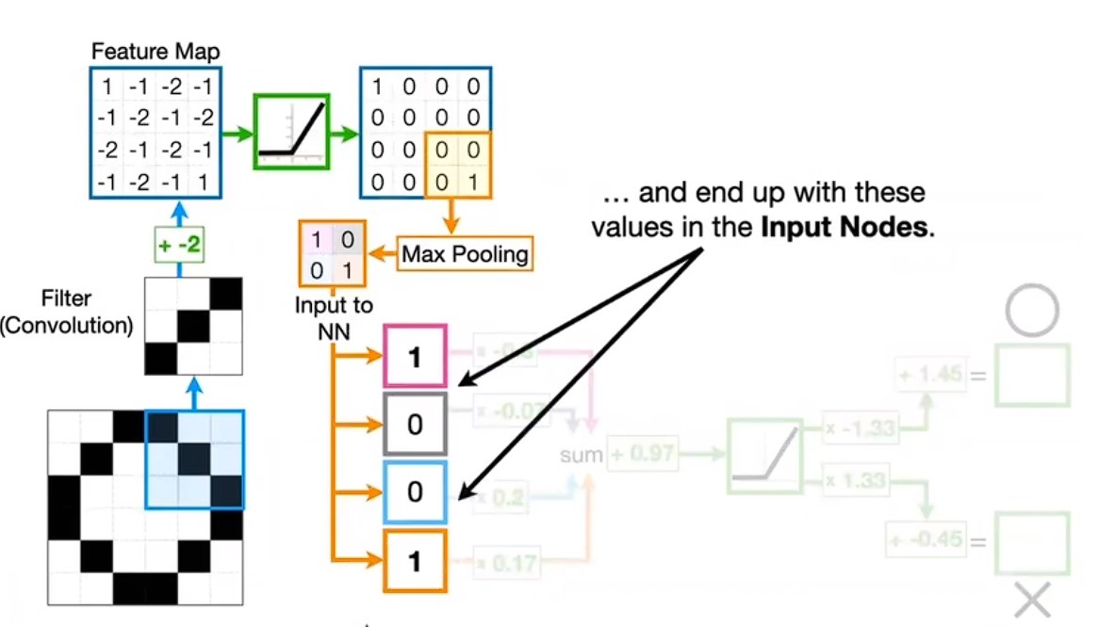
Step-3:
flattening

Slide 20
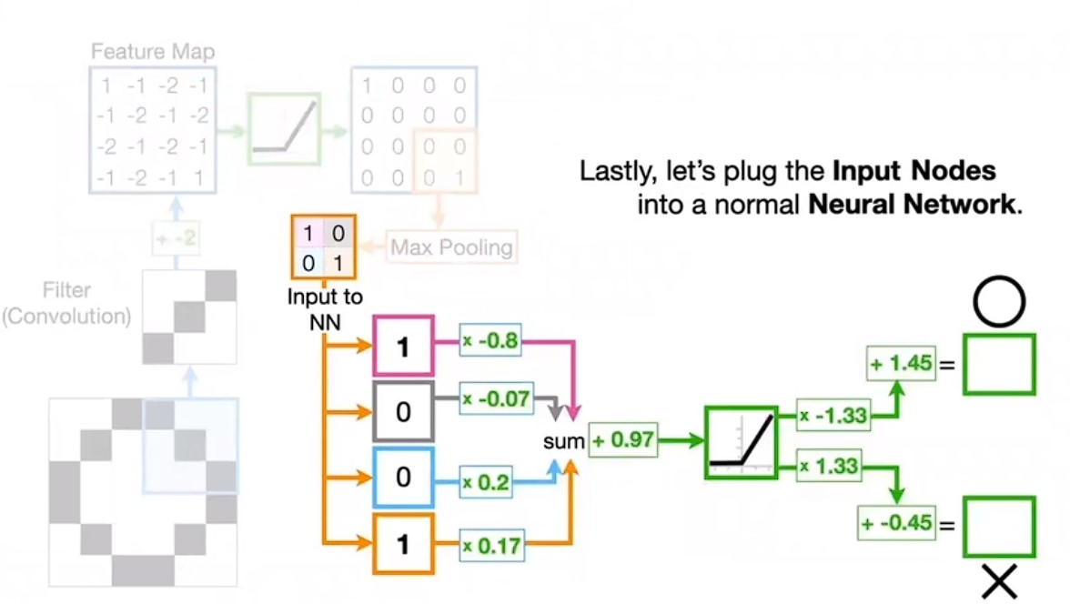
Step-4:
full connection

Slide 21
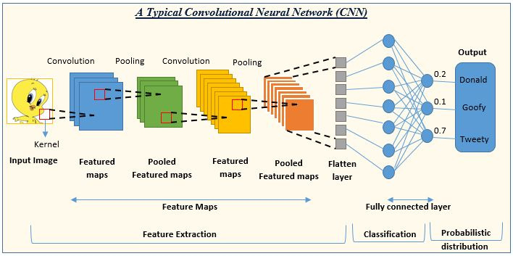

Slide 22
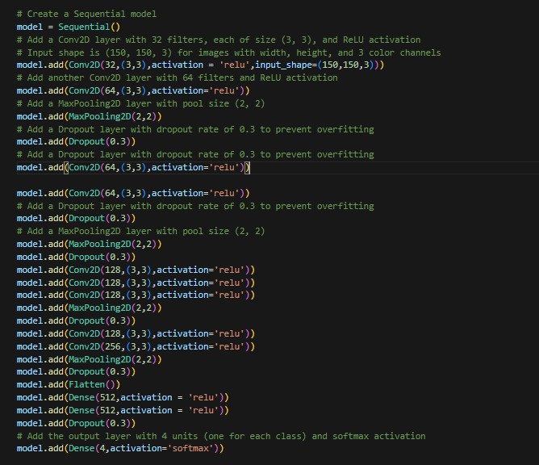

Slide 23
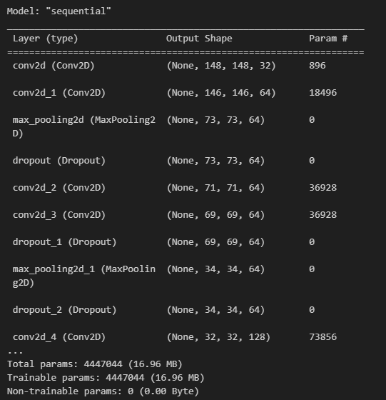
Neural Network Architecture

Slide 24
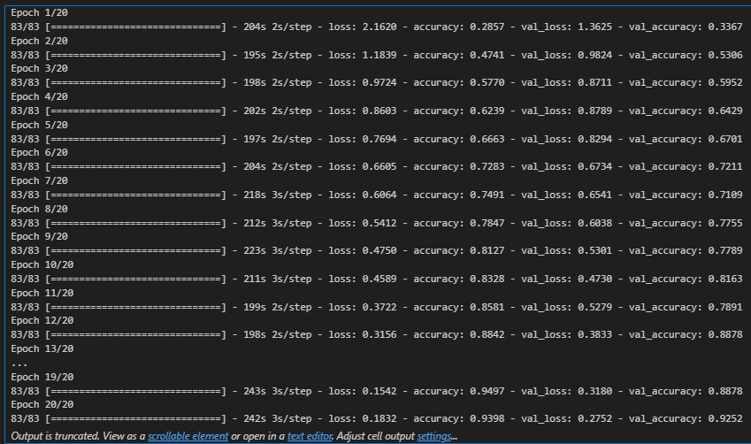
Neural Network Training and Evaluation

Slide 25
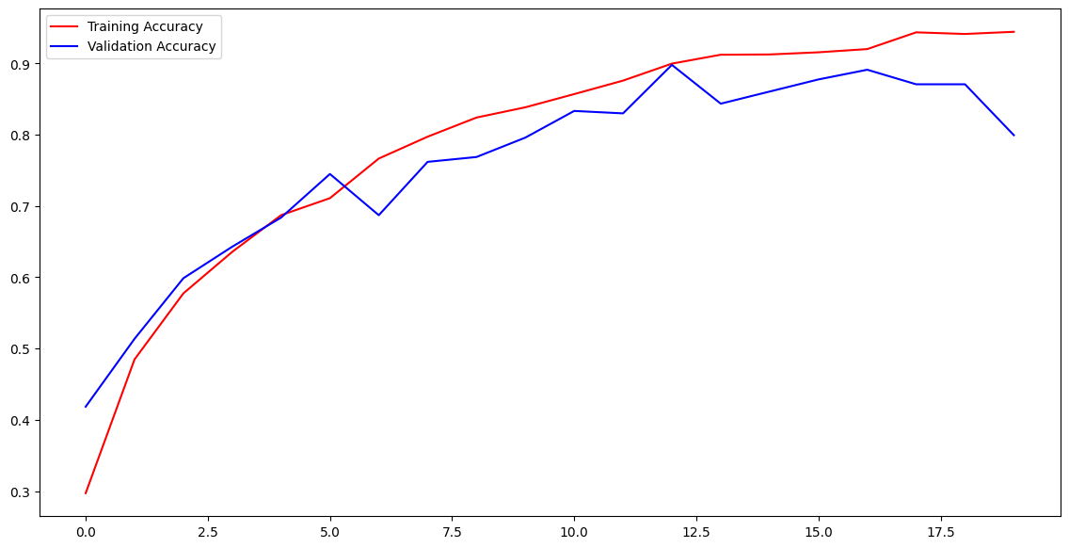
Training and Validation Accuracy

Slide 26
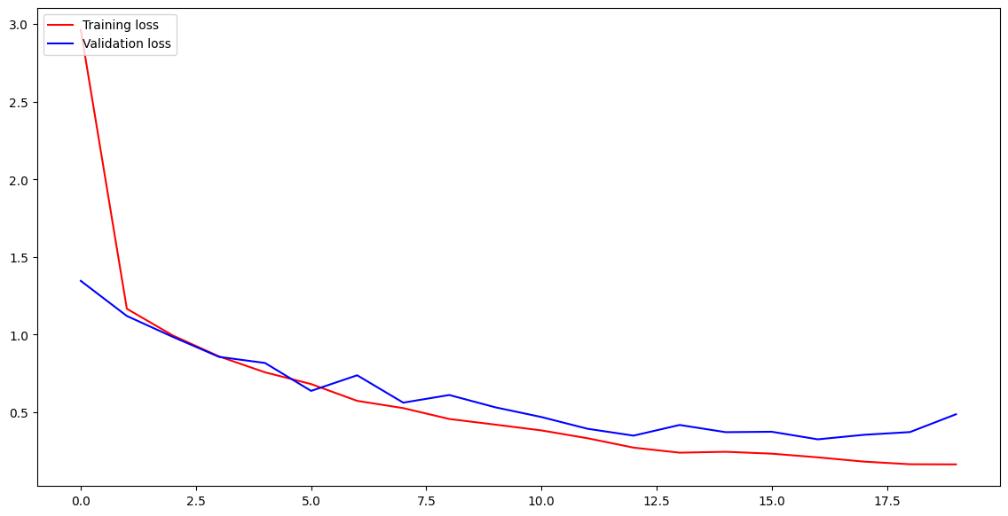
Training and Validation loss

Slide 27
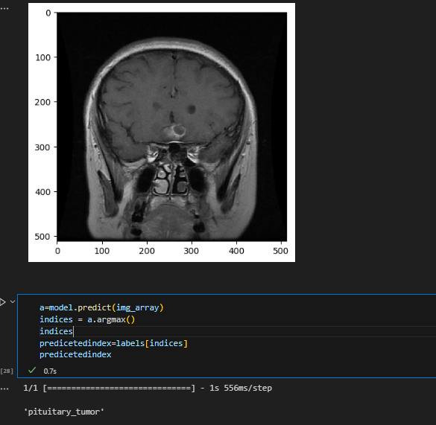
Prediction using trained model

Slide 28



Conclusion
We were able to create and train a model that gives us very high accuracy.
The neural network model has been trained for 20 epochs. The training accuracy has improved over the epochs, reaching around 93.98%, and the validation accuracy has also improved, reaching about 92.52%.
This indicates that the model is learning from the data and is able to generalize well to unseen validation data.

Slide 29
Limitations
Small dataset size
Limited diversity in training data
Class imbalance between tumor and non-tumor samples

Slide 30
future work
Expand the dataset with more patients to improve generalization
Include multiple tumor types for a comprehensive model
Implement ensemble modeling by combining various CNN architectures
Deploy the trained model in a clinical setting for real-world validation

Slide 31
References
https://www.kaggle.com/code/loaiabdalslam/brain-tumor-detection-cnn
https://www.ncbi.nlm.nih.gov/pmc/articles/PMC9468505/
https://ieeexplore.ieee.org/document/8934561

Slide 32



THANK YOU

